Slide 1
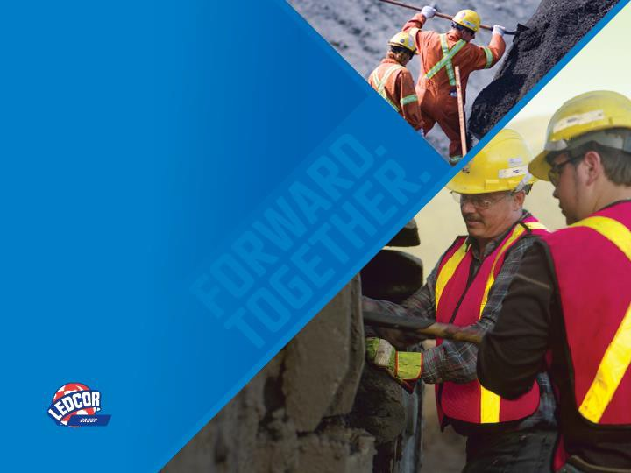





EXPOSURE TO
THE COLD
November 6, 2013

Slide 2



















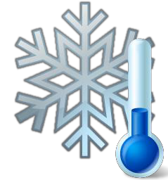































WHAT IS COLD STRESS
Cold stress is the transfer of body heat out to a
colder environment
When you are exposed to a cold environment, most of your body's energy is used to keep your internal temperature warm
A cold environment forces the body to work harder to maintain it’s temperature

Slide 3







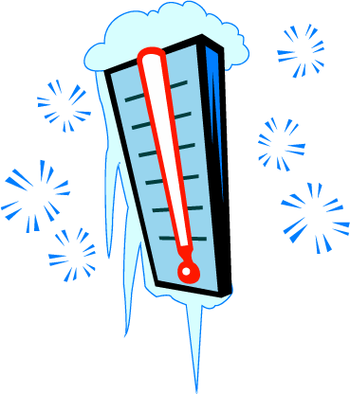











DID YOU KNOW..??
At -55 °C the skin will freeze in less than two minutes of being exposed
Cold stress is usually the result of being improperly prepared for changes in weather conditions and a lack of knowledge about exposure to the cold
It is important to remember that cold stress isn’t just a result of working in extreme weather conditions

Slide 4


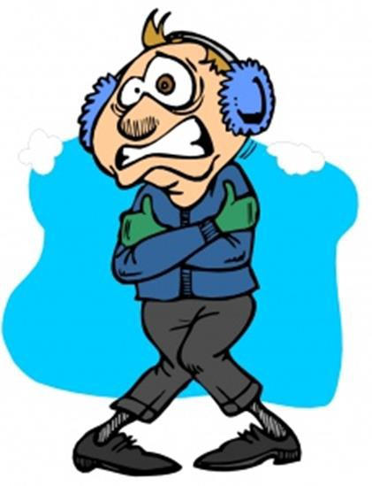







FACTORS THAT INFLUENCE HEAT LOSS
Air temperature
Wind speed
Humidity / moisture
Direct contact with cold surfaces
Physical activity
Work / rest cycle
There are several factors that can influence how we gain and lose heat

Slide 5







































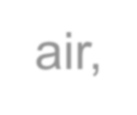














































COLD INJURIES
Exposure to the cold can threatening
be hazardous
or even
life-
Your body's extremities, such as the ears, nose, fingers and toes, lose heat the fastest
  The more skin that is exposed to the air, the faster the body
will lose heat because a greater surface area is exposed
  Once the skin senses cold, the blood travels back to the body core to protect the major organs
The three most common injuries that result from exposure
to the cold are:
  Frost nip
  Frost bite
  Hypothermia

Slide 6









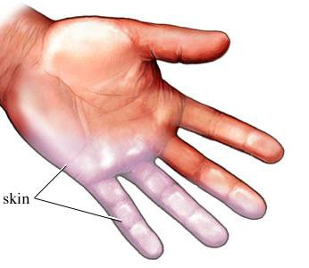


FROST NIP
Mildest form of an injury from exposure to the cold
Occurs when only the top layer of skin freezes from exposure to the cold
  Ear lobes, nose, cheeks, fingers or toes
Skin appears to be white or yellow in colour
Top layer of skin feels hard, but the deeper tissue still feels soft
May experience painful tingling or burning sensation
After the first signs of frost nip,
frost bite will develop within 60 seconds

Slide 7












FROST BITE
More severe than frost nip
The skin loses water and other tissue (fat / muscle / bone) is frozen in addition to the skin being frozen
Skin appears white, waxy, and it feels hard to the touched
Sensations in affected area; cold, stinging, tingling, or aching followed by numbness
Most likely to occur in the extremities (toes / fingers / ears / nose / face)
OR
Large areas of skin exposed to cold conditions

Slide 8


HYPOTHERMIA
Occurs when body heat is lost faster than it can be produced
Exposure to cold over a long period of time, without using adequate controls, may
cause the core temperature of the body to drop below normal temperature (37 °C)
Core body temperatures below 37 °C can cause serious damage to vital organs and if left untreated, may lead to death
Signs of hypothermia include:
  Shivering; the body’s natural reaction to try and increase the core temperature
  Confusion; unable to process information as quickly / loss of focus
  Loss of muscle control; may find walking difficult / “drunken stagger”
  Increased breathing rate;
Having clothing against the body that is wet or damp will increase the rate at which
hypothermia sets in
It is critical to seek treatment immediately if you feel that you or one of coworkers are suffering from sign of hypothermia

Slide 9









TREATING COLD STRESS INJURIES
When dealing with cold injuries, follow these steps to ensure you do not cause more damage to your body:
Notify your supervisor immediately if you think you may have signs of exposure to the cold
Remove all wet / sweaty / damp clothing immediately
Never rub or massage the area or apply direct heat
Do not apply direct heat to the area because you may burn the skin
Warm the area gradually with body heat or warm water
Once the area is warm, DO NOT re-expose it to the cold
Seek medical attention ASAP

Slide 10

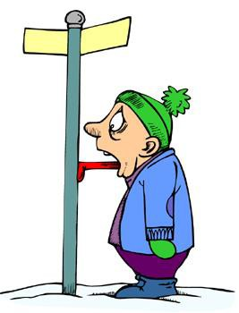




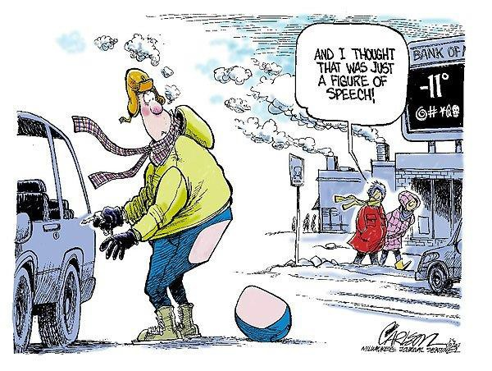


PREVENTING COLD STRESS
Education —
Workers should be coached to recognize the signs of cold induced illnesses and injuries. Also, you should assess the environmental and worksite conditions that may lead to cold stress each day before beginning your work tasks
Buddy system—
Communicate with your crew about how to recognize the signs of cold stress in others. Most times we can’t identify the early signs ourselves, so watch out for your co-workers and others around you
Stretch and Flex —
When blood flow decreases, muscle function also decreases. This can cause muscle reaction time to become slower. Stretch and flew through the day to increase blood flow to the major muscle groups, and keep your body warm
Working conditions —
Be sure to monitor the length of time you are exposed to cold conditions. Take micro breaks as needed to warm up and stay hydrated

Slide 11


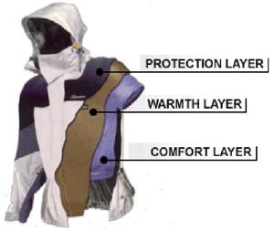
Layer your clothing —
PREVENTION CONT.
It is better to wear several thin layers of clothing instead of wearing fewer layers of thick clothing. Base layers are very important
Choose synthetic fabrics (rayon / polyester / acrylic) or wool as your base layer to absorb moisture. A middle layer could also be wool or synthetic to provide insulation
Choose fabrics made of waterproof and wind resistant material for your outer layer of clothing to create a barrier against the elements while allowing ventilation to prevent overheating
Cover your face and head with a balaclava or a toque. Up to 40% of heat can be lost when the head is left exposed
Keep a change of dry clothing available
in case work clothes become wet

Slide 12


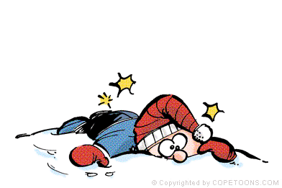
PERSONAL PROTECTIVE EQUIPMENT
In addition to layering your clothing, you must ensure that your PPE fits correctly over top of your winter wear
CSA approved winter gloves
Steel toed boots (rated for cold temperatures) with the appropriate
traction aids
CSA approved eyewear
High visibility striping on your outermost layer
***Remember, if you choose to take layers off throughout the day, you
MUST put your stripes back on
Proper ear covering / toque / balaclava
Be sure to check with your supervisor with regards to any additional items you may need

Slide 13
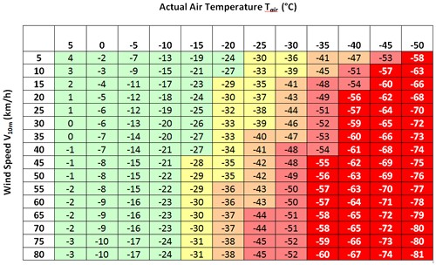
WIND CHILL CHART
Use a wind chill chart to determine the actual outdoor temperature when getting dressed for work in the morning

Slide 14
Questions Comments Concerns
THINK SAFETY WORK SAFELY

